Slide 1
LIS6946 Supervised fieldwork project companion deliverable
Susan Boyle
University of West Florida Internship
Fall 2021

Slide 2
Introduction
Supervised Fieldwork at University of West Florida’s John C. Pace Library
Site Supervisors:
Cindy Gruwell, Assistant Librarian/Coordinator of Scholarly Communication
Liza Campbell, Associate Librarian/Technical Services Director
Fall 2021

Slide 3
Identifying the project
FL Islandora is a partnership between UWF Libraries and Florida Virtual Campus https://libraries.flvc.org/
The Florida Virtual Campus (FLVC) decommissioned an old server and moved all of UWF’s Electronic Theses and Dissertations to a new server. During bulk moves like this, it was very important to UWF’s Tech Services department to ensure that none of their resources were lost, misplaced or corrupted during this transfer. They needed documentation on what had been done in case documents needed to be moved to another server and to identify and mitigate any losses.

Slide 4
FL Islandora Metadata cleanup and database project
The Problem:
During this transfer to the new server, FLVC moved everything UWF had in the old server, both Dissertations AND Theses, into a single “Theses” folder, necessitating someone to manually examine each item and split them into their separate, correct folders.
At the same time, most objects were corrupted in such a way that all “names” detected in the records were placed in the “Creator” field. At the beginning of this project, several entities other than the correct Author/Creator were listed in the “Creator” field, such as Committee Chair, Degree Granting Institution, etc.

Slide 5
FL Islandora Metadata cleanup and database project
Project:
1) Go into the datastreams of each of the 800+ records in the UWF Theses folder one by one and edit the datastream by deleting the extraneous names/entities listed in the Creator field, and ascribe the correct Rights Statement Value (“In Copyright - Educational Use Permitted”). If the resource is a Dissertation, migrate that resource to the UWF Dissertations Collection.
2) List every object in the Theses and Dissertations database and its relevant metadata (sourced from the FL Islandora and the UWF Library Catalog) in a shareable Google Sheet and note any irregularities needing modification.

Slide 6
Usefulness/significance/Expectations
Tracking assets in the database and cleaning up after this migration has proven to be very useful. UWF Librarians are using the database on a daily basis, checking links and filling in incomplete data in other databases.
While the expectation for this project was to get some (not all) of it done, as there was not enough time in the semester to complete it, I did sincerely try to get through it all. A new staffer onsite at the UWF John C. Pace Library will be taking over where I left off. Right now, I’m up to record #290, but I plan to keep working at it until the end of the semester.

Slide 7
Project walk-through
The next few pages show each step necessary to access, check and update/re-file and log each record….

Slide 8
Florida Islandora UWF Theses & Dissertations
Log in to the behind-the-scenes metadata-accessible FL Islandora database. This is the
cover page

Slide 9
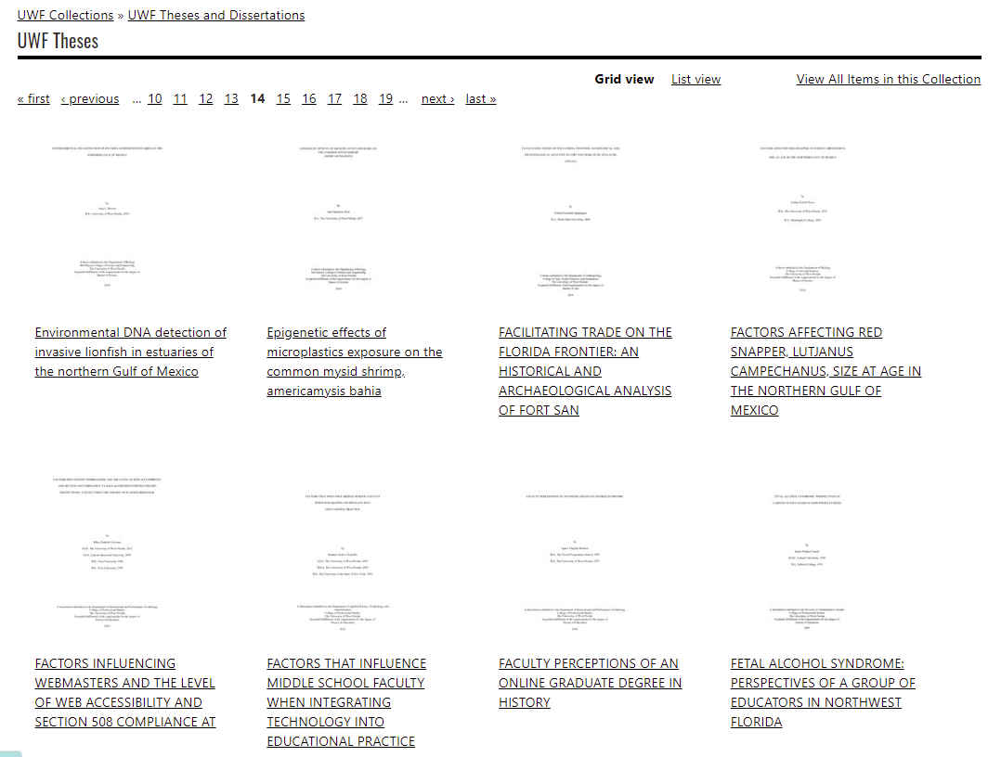
Open the object

Slide 10
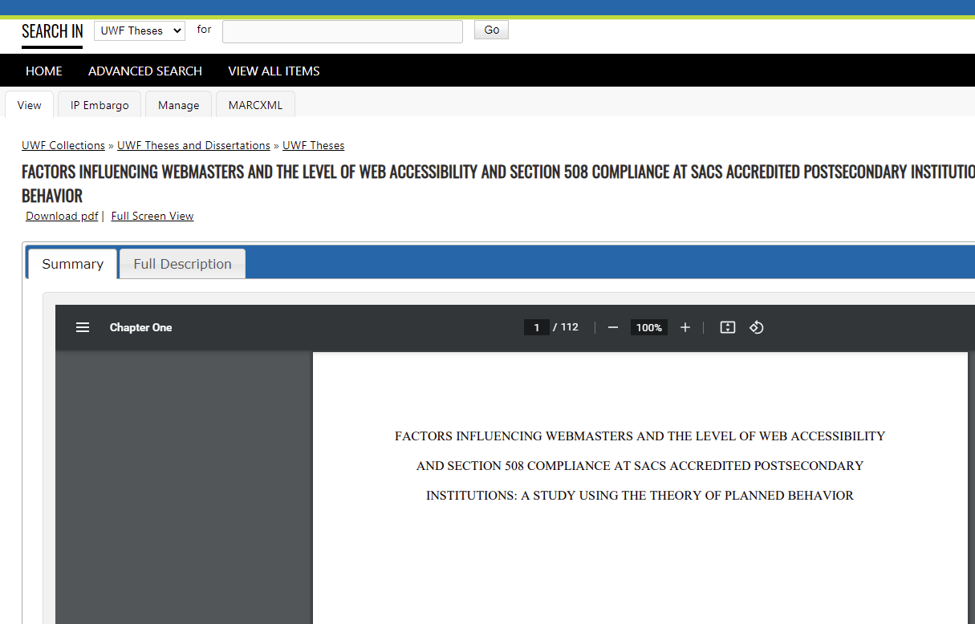
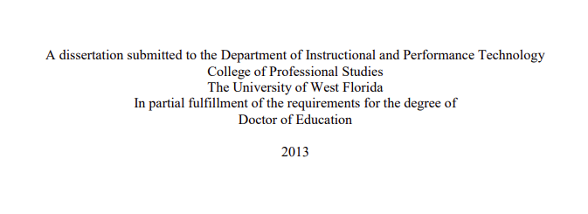
Summary page shows a PDF of the document. The view of the cover shows whether the item is a Theses (in the correct folder) or a Dissertation (needs to be migrated out). This object is a Dissertation.

Slide 11
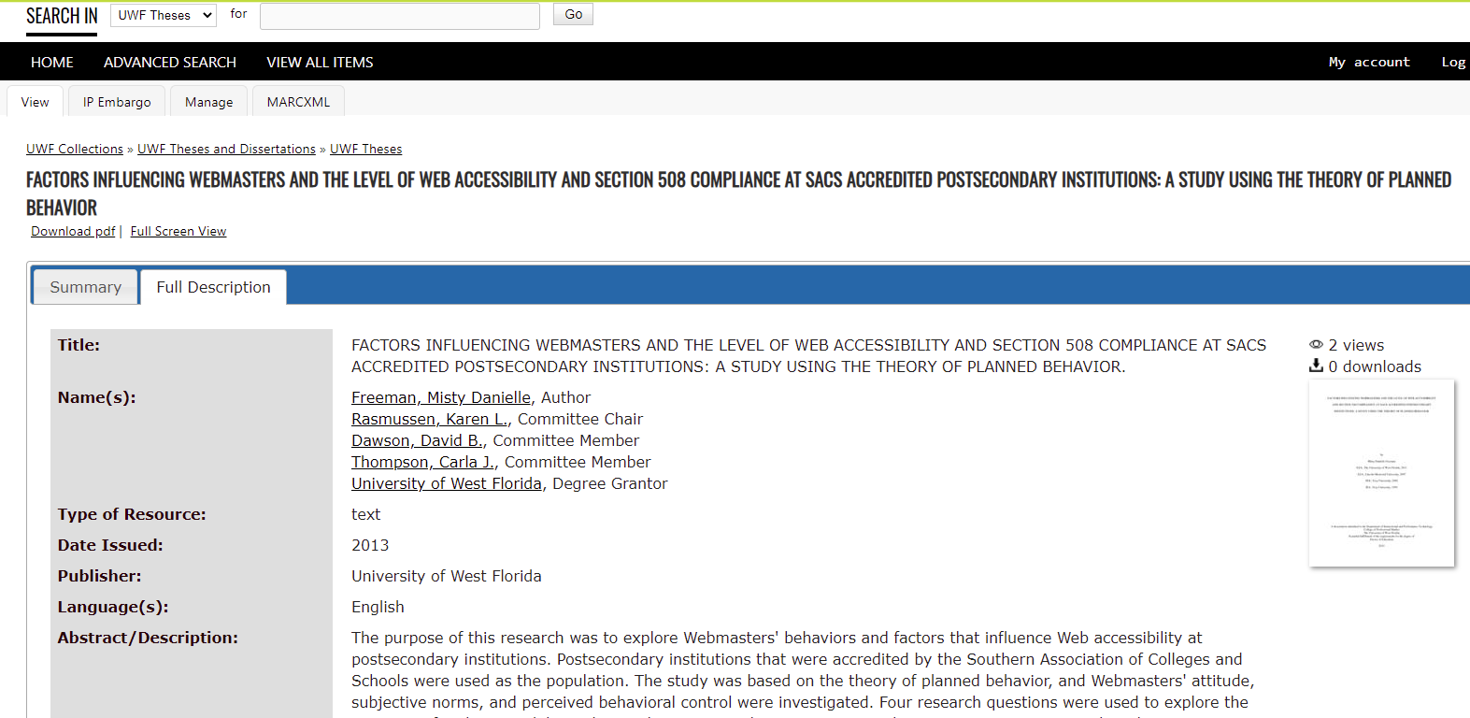
This Full Description shows 5 creators, but there should be only one Author listed here

Slide 12
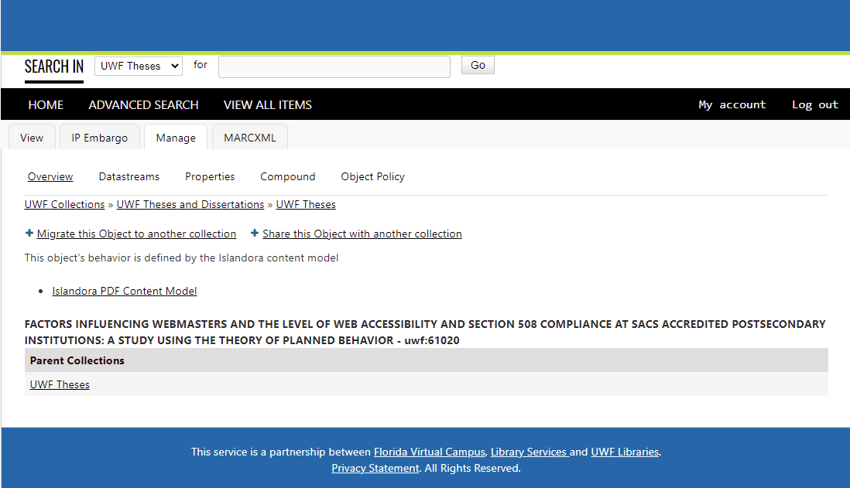
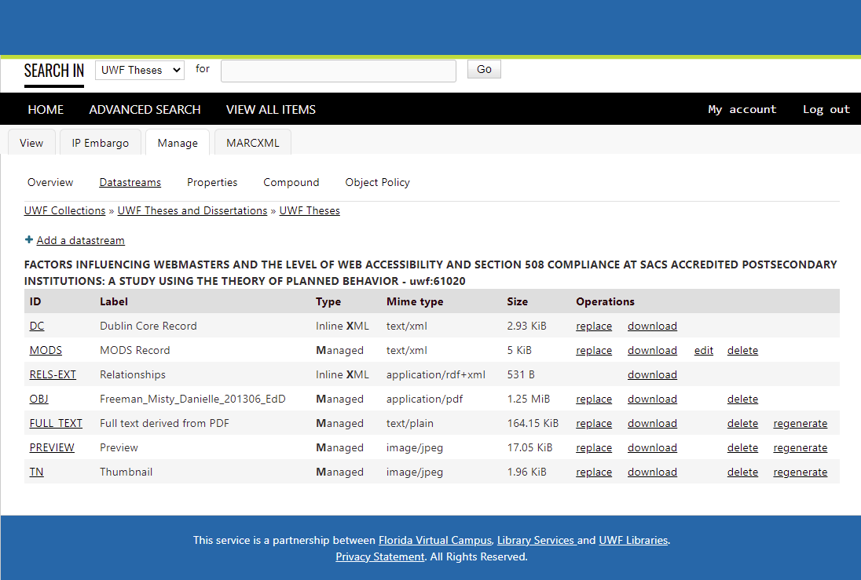
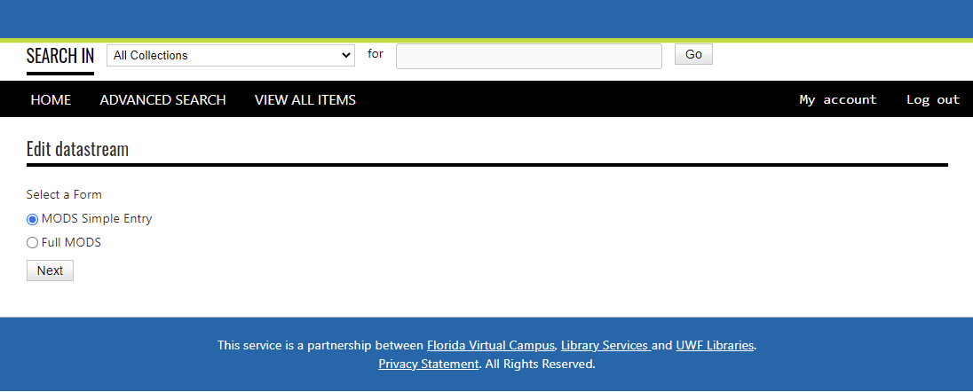
1. Click Manage Datastreams
2. Click edit MODS Record
3. Click MODS Simple Entry

Slide 13
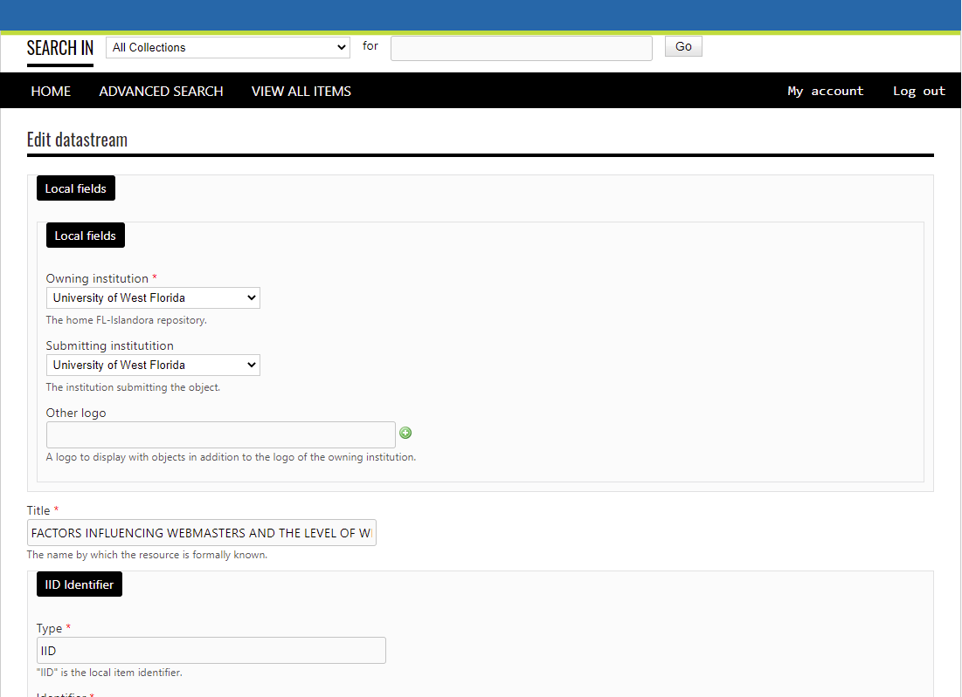
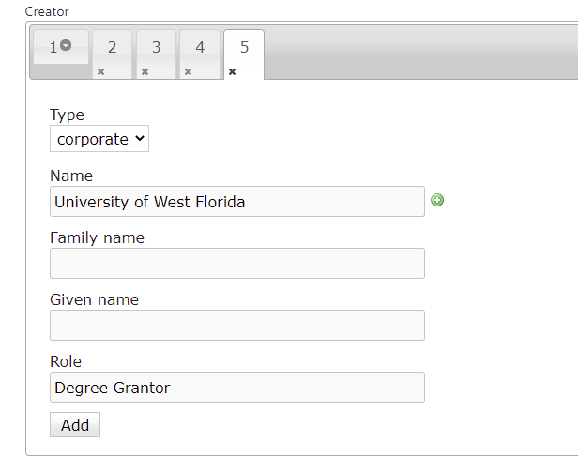
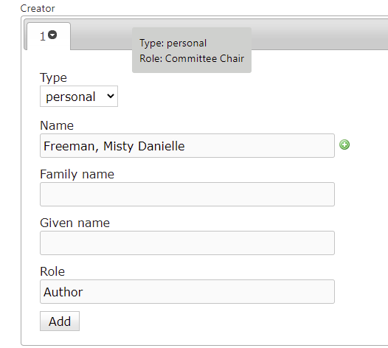
Editing the datastream
Click the x’s to delete each entity under Creator, except the first one, the Author
Now there is only one Creator listed

Slide 14
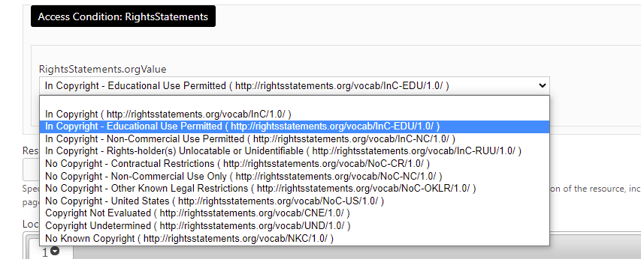
Scroll down to the RightsStatements menu
Dropdown menu shows “In Copyright – Educational Use Permitted.”
Select “In Copyright – Educational Use Permitted.”

Slide 15
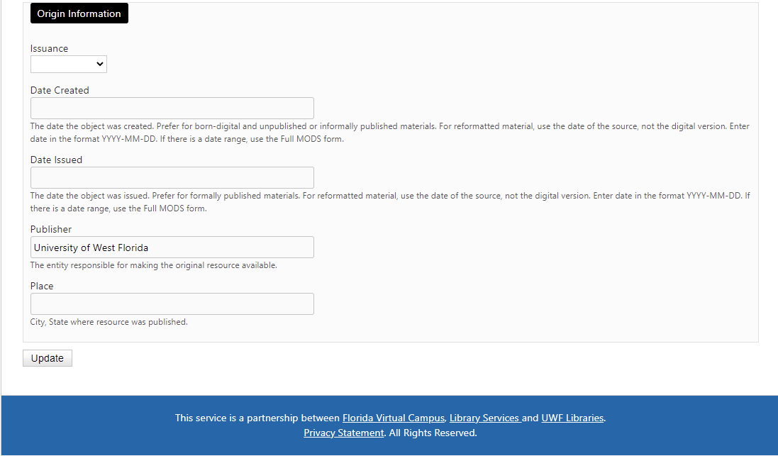
Scroll to bottom of record and hit Update
When updated record appears, only one name should now appear in Name(s): location field

Slide 16
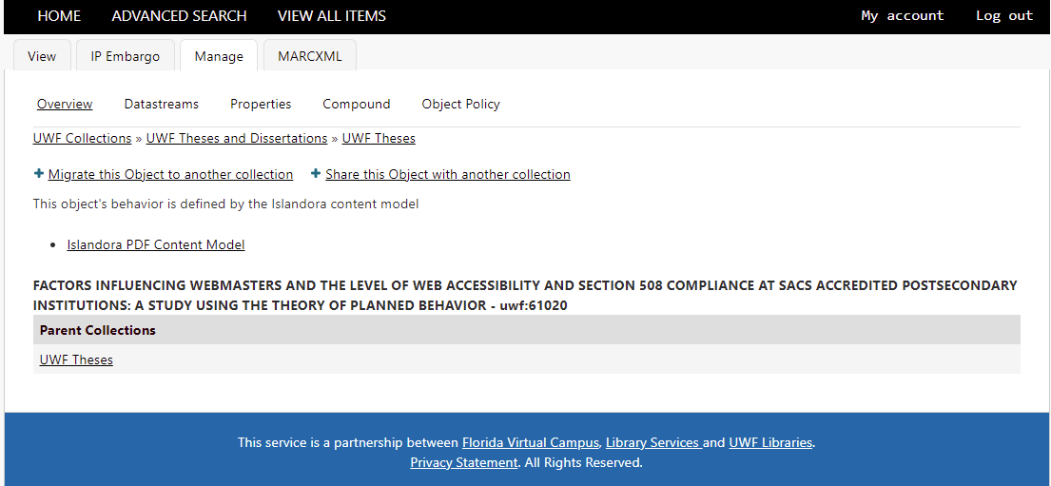
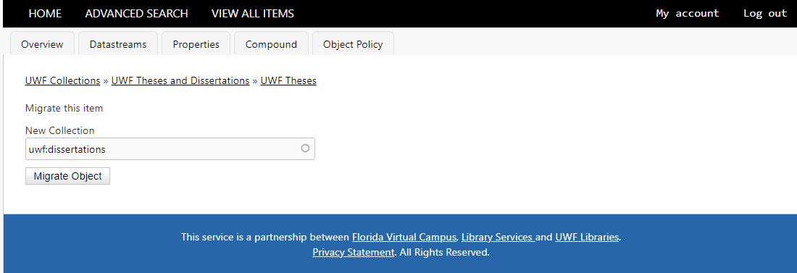
Since this is a Dissertation, click Manage and +Migrate this Object to another collection to move it
Type “diss” in the dropdown to locate “uwf:dissertations” folder, and click Migrate Object

Slide 17
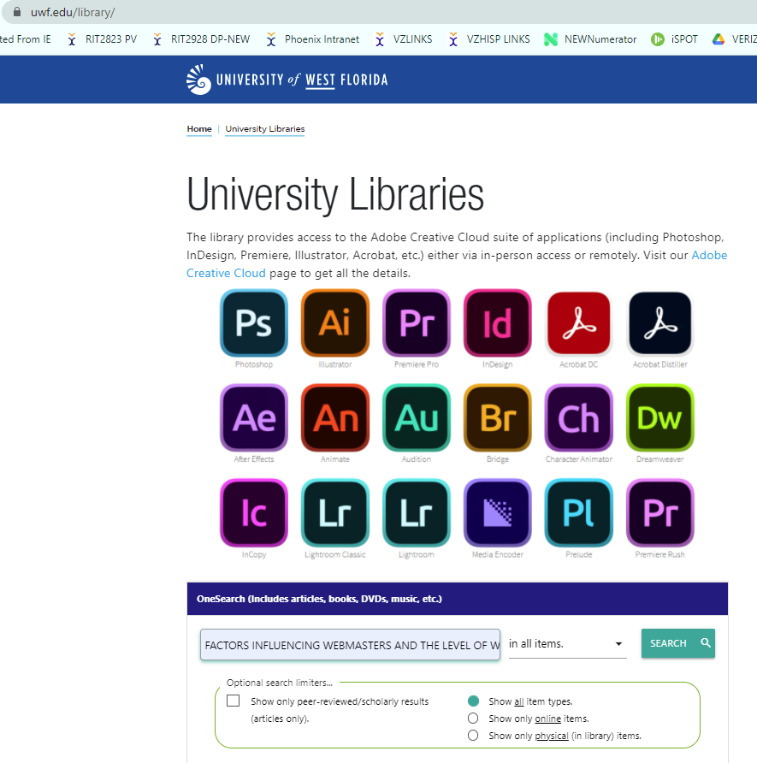
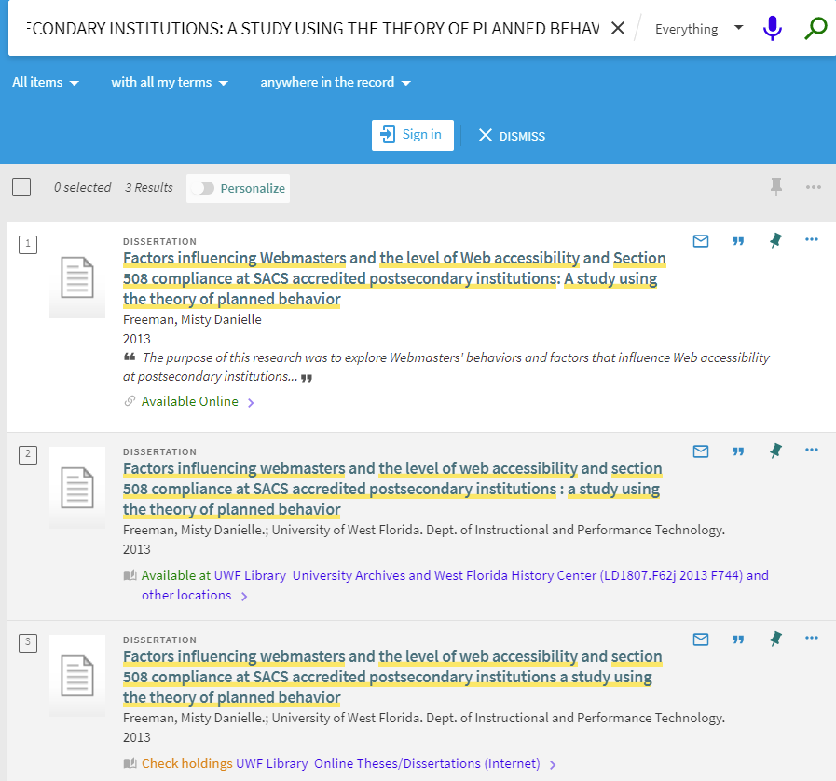
Search for this item in the UWF Library Catalog at https://uwf.edu/library/
Click the link to find the details

Slide 18
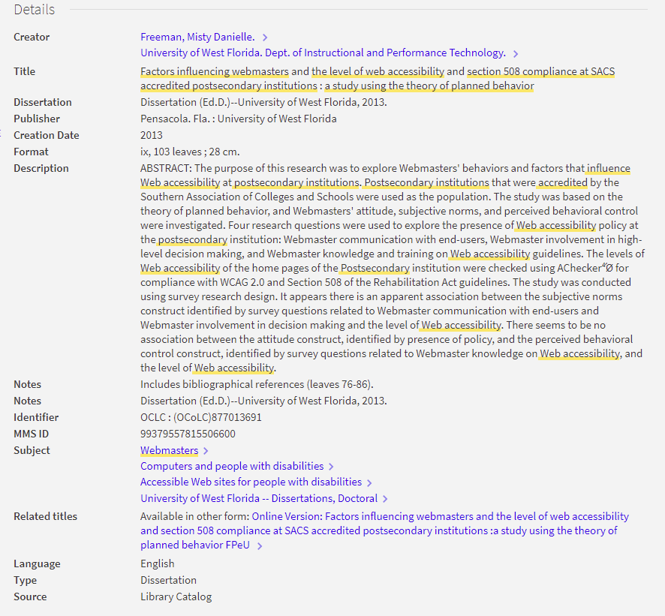
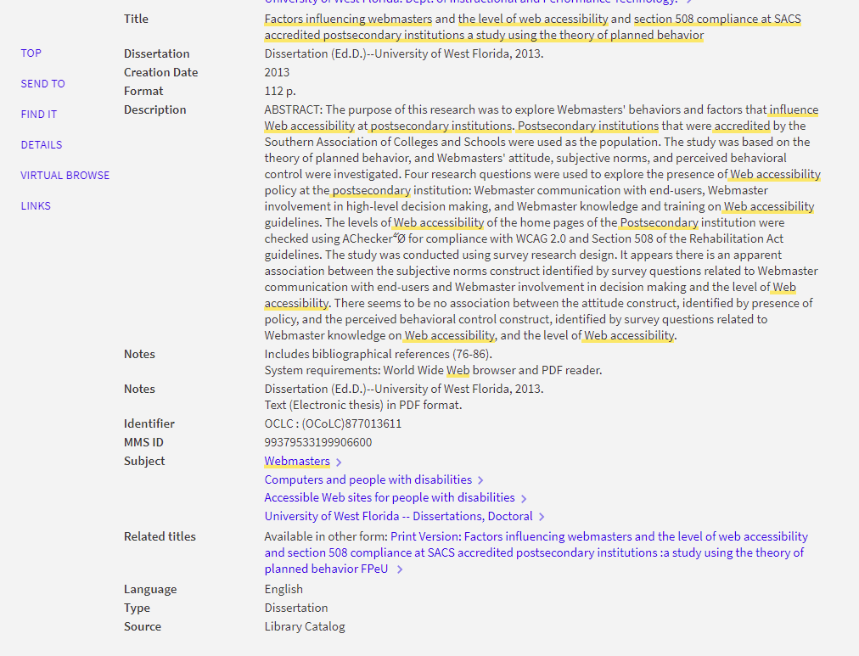
Click here to make sure you’re looking at the data for the Online version
Copy the MMS ID number and paste it in the Google Sheet

Slide 19
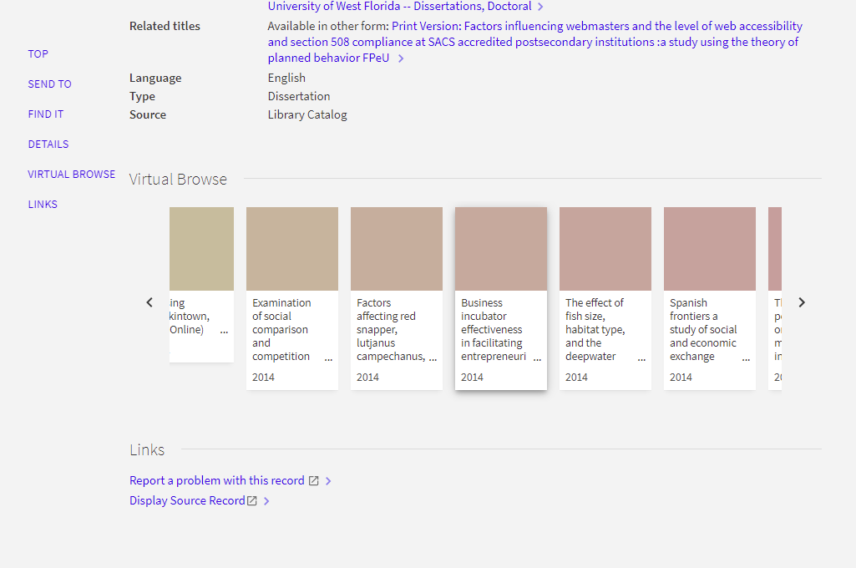
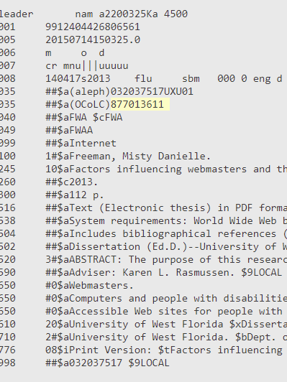
Scroll down to find the Display Source Record link and click it
Copy the Aleph number and OCLC number and paste them into the Google Sheet
The Aleph number is an ID number for the online system (Staff side) of the library catalog in ILS and an old Integrated Library System that was updated recently to ALMA.

Slide 20
FL Islandora Metadata cleanup and database project
Screenshot of the database in shared Google sheets

Slide 21
Thank you for this opportunity
Susan boyle, MLIS, USF, Fall 2021

