Slide 1
"Quantifying preferences of USF students for physical textbooks vs. electronic resources" LIS 6271 Research methods e-presentation
Fall 2020
Team Boyle/Crim/Gresham/Merrill/Trotter

Slide 2
Significance of the Study/Research Goal & Questions
This study is an attempt to understand the link between students having a choice of format for their textbook (as e-book or printed) and their academic outcomes and student experience
The study will also investigate the effects, if any, the COVID-19 pandemic of 2020 had on student choice between selection of e-textbook or print textbook

Slide 3
Research Problem/Needs Assessment
Recent research shows that the switchover to e-texts has not been easy
Sales of e-books have stalled, and several small studies show that students prefer the printed textbook to the e-book format (Gregory & Cox, 2017)
Before more schools mandate the use of e-textbooks over printed texts, and before printed texts become hard to find (or nearly impossible to afford), more information is needed on student preference, learning style and usage of texts in both formats
Today’s focus on e-textbooks over printed materials might be disadvantageous to certain students in terms of their grades or their satisfaction with the course

Slide 4
Literature Review – Part One
Grouped articles on the status and evaluation of previous research.
​
Focus of Literature Review
​
Article organization and groupings from prior research.
Early Researchers' findings.​ (Chuckov, 2013; Falc, 2013)

Slide 5
Literature Review – Part Two
Limitations to previous research and new considerations.
​
Previous research guided by external factors. (Chen, 2013)
​
Researchers limited by generational leanings or bias. (Alhammad, 2016; Falc, 2013; Gregory & Cox, 2017)
Future research should consider catastrophes that force students into a new (virtual) learning environment.​

Slide 6
Survey Design and Instrumentation
Voluntary, self-administered online survey via Qualtrics to collect quantitative data in a cross-sectional survey design.
Demographics
Student preference for electronic versus print textbooks for courses
Format choice (whether mandated by the professor or by choice), impacted final course outcomes.
Investigate if COVID-19 had any impact on student choice of textbook format
USF College​​ Undergraduate and Graduate Students
Arts & Science
Business
Engineering
*Med
*Med represents students majoring in Nursing and Health Sciences​

Slide 7
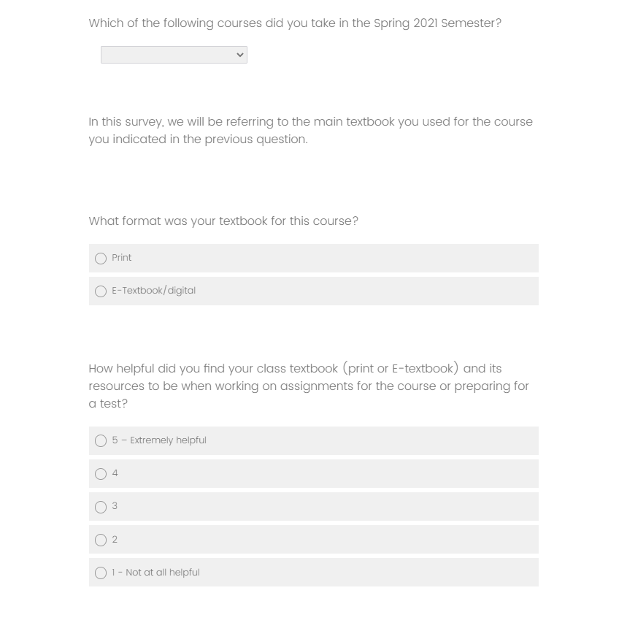
Multiple choice, Likert scale, and open-ended questions
Survey should take less than 10 minutes to complete and can be taken on a desktop or mobile device
As an incentive, students who completed the survey in full will receive a $5 Amazon Gift Card
Example from Qualtrics survey

Slide 8
Project Resources – Principal Investigators
Jocelyn Crim & Susan Boyle
Identify courses for sampling
Kate Gresham
Monitor fieldwork
Send emails & reminders
Meg Merrill & Ben Trotter
Primary data analysis
Correspond with College Deans/Dept Chairs for survey distribution
Oversee graduate student analysts

Slide 9
Project Resources - Timeline

Slide 10
Project Resources - Budget
 | Budget
Access to Qualtrics (USF License) | $0
Respondent Incentives: $5 Amazon E-gift cards per completed survey, Total of 1590 outgoing invitations Estimated response rate 50% 1590 x .5 = 795 Completes x $5 incentive | $3,975
2 Graduate students to conduct analysis at $12/hour for approximately 6 hours each | $144
TOTAL | $4,119

Slide 11
THANK YOU
For more information, contact:
Susan Boyle: SusanBoyle@usf.edu
Jocelyn Crim: raejurlina@usf.edu
Kate Gresham: kate6@usf.edu
Meg Merrill: mmerrill1@usf.edu
Ben Trotter: btrotter1@usf.edu

